Slide 1
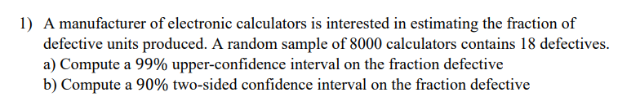

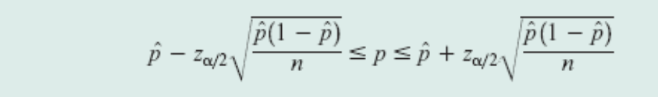
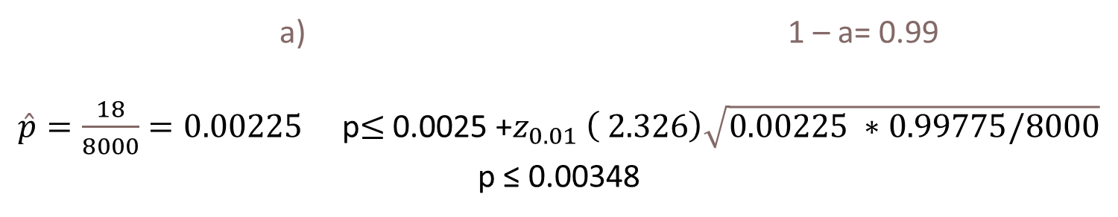
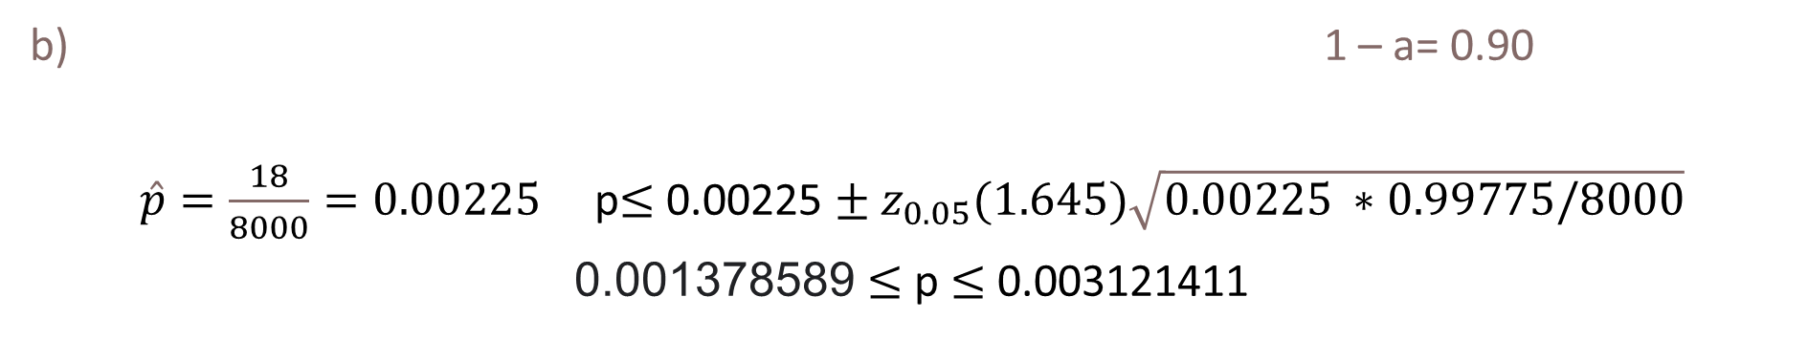
a) 1 – a= 0.99
$\hat{p}=\frac{18}{8000}=0.00225$ p$≤$ 0.0025 +$z_{0.01} \left( 2.326\right)\sqrt{0.00225 ∗0.99775/8000}$
p ≤ 0.00348
b) 1 – a= 0.90
$\hat{p}=\frac{18}{8000}=0.00225$ p$≤$ 0.00225 $±$ $z_{0.05}(1.645)\sqrt{0.00225 ∗0.99775/8000}$
0.001378589 $≤$ p $≤$ 0.003121411

Slide 2

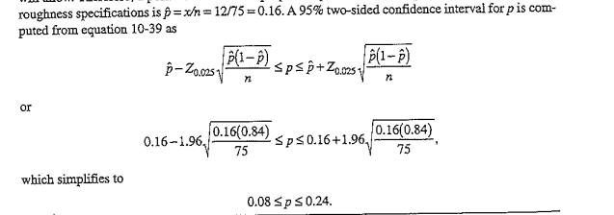

Slide 3
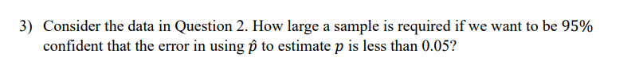


Slide 4
